Slide 1
OCCUPATIONAL HEALTH & SAFETY
(Supervisors)
WSCC

Slide 2
Today’s Objectives
Prevent Injury, illnesses and disease in the workplace
Provide overview on the legal responsibilities for Employers, Supervisors and Workers
Identify the reasons we need to participate in Safety Management Systems
Help identify improvement opportunities to be compliant at your work place

Slide 3
Workers’ Safety & Compensation Commission
Our Vision
Eliminate Workplace disease and Injuries
Our Mission
In partnership with stakeholders, we ensure
workplace safety and care for workers

Slide 4



Three Reasons:
Moral
Legal
    Financial
Notes:
1-11
Reasons for Exercising Responsibilities:
Moral – no one wants to get hurt
Legal – proof of reasonable precautions & measures for safety
Financial – working safely is good business

Slide 5
NWT Statistics
YEAR #
Reported Injuries to the WSCC 2016 3587
Reported Injuries to the WSCC 2017 922
Lost Time Injuries 2016 824
Lost Time Injuries 2017 330NWT&NU
Canada 1000 per year die of Workplace injuries
NT & NU 2011-2017 19
Occupational Disease 2016 32
Occupational Disease 2017 21
Fatalities 2017 1

Slide 6
Workers’ Safety & Compensation Commission
Northwest Territories and Nunavut Worker Protection Administrators
- Safety Act and Safety Regulations
-Workers’ Compensation Acts
-Mines Health and Safety Acts
-Explosives Use Acts
-Associated Regulations
-Codes of Practice
Notes:
I-4
The WSCC administers the:
Workers’ Compensation Acts
Safety Acts
Mines Health and Safety Acts
Explosives Use Acts
Associated Regulations
to protect Workers in the NWT and Nunavut.

Slide 7

Authorities & Legal Obligations
Safety responsibilities mandated by:
external legislation and regulation
internal corporate policies, guides, manuals and best practices
Notes:
1-2 to 1-3
Your company policies and safety directives, the Safety Act and General Safety Regulations and the Workers` Safety & Compensation Act all have very specific reporting requirements that Supervisors must follow.
Supervisors are legally required to complete any legislative and corporate requirements.

Slide 8
Federal Legislation Criminal Code 217.1:
“…everyone who undertakes, or has authority to direct how another person does work or performs a task is under legal duty to take reasonable steps to prevent bodily harm to that person, or any other person, arising from that work or task.”
Notes:
1-18

Slide 9
Criminal Code Section 217.1
Federal
Territorial/Provincial
Municipal
Corporations
Private Companies
Charities
Non-Government
Individuals
Notes:
1-18
Establishes criminal liability in Canada for organizations and their representatives including:
Federal;
Territorial or Provincial;
Municipal;
Corporations;
Private companies;
Charities; Non Government organizations; and
Individuals

Slide 10
Safety Act & Occupational health and Safety Regulations
NEW SAFETY REGULATIONS
  A rule made by an authority
  Specific rules and standards to be complied to…. example
First Aid
General Duties of Employers
Supervision of Work
  SAFETY ACT
  A law passed formally by parliament
  Act defines who it applies to….example
Section 4 applies to; “Every Employer shall”
Section 5 applies to;
“Every Worker shall”
Section 6 applies to;
“Every Supplier shall”
Notes:
1-2 to 1-3
Have students read and review page 1-2 and discuss the general duty clause. Similar requirements across all jurisdictions.
Emphasize the “and”.
Emphasize “person”.
Explain the Act tells what is required. To know what an employer must do to meet the First Aid requirements of Section 4(1)(c) the employer will reference the Safety Regulation on First Aid.

Slide 11
Codes of Practice
  Asbestos Abatement
  Hazard Assessment
  Traffic Control Person
  Thermal Conditions
  Personal Protective Equipment
Notes:
1-8
Refer students to remain current with the WSCC Codes of Practice on the website. It is not listed under legislation but has it’s own page.
Emphasize these are quasi-legal documents and may be used to demonstrate due diligence.

Slide 12
Enforcement
Safety Act and OHS Regulations
Easier to say where it doesn’t get enforced
  Mines (Mine Health and Safety Act and Regs)
  Federal employers (Canada Labour Code)
    (Banks, RCMP, Off Shore, Airports, etc.)

Slide 13
Non-Compliance
Non compliance, contravention to the Safety Act and/or Regulations can lead to penalties;
Safety Act section 22
  Sub-section 2, Employer or person acting on behalf $500,000.00
  Sub-section 4, every person employed at the operation (Supervisor), $50,000.00
  Sub-section 5, every worker who condoned the offence, $25,000.00
  Sub-section 5.1, every supplier $500,000.00

Slide 14
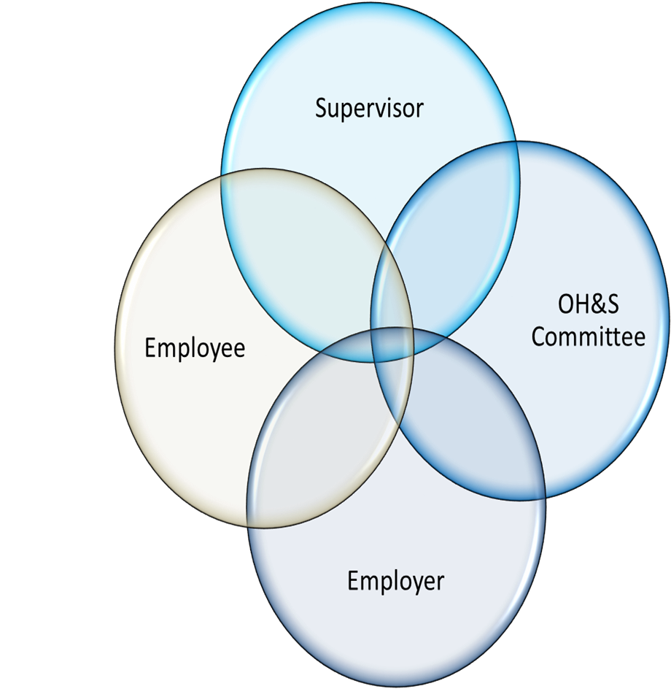
IRS – INTERNAL RESPONSIBILITY SYSTEM
Safety Culture
J
Attitudes, Beliefs, Behaviors, Perceptions

Slide 15
Internal Responsibility System
Sharing the Health & Safety Responsibility
Producing Safety Culture
Following Best Practices
Self Reliance
Ensuring Compliance
Notes:
1-9
Establishes responsibility sharing systems
Promotes safety culture
Promotes best practices
Helps develop self reliance
Ensures compliance

Slide 16

Due Diligence is taking all reasonable precautions and adopt and carry out all reasonable techniques and procedures to ensure the health and safety of every person in your establishment.
What is Due Diligence
Provide information, instruction, training and supervision that is necessary to protect the health and safety of your workers
Identify possible
workplace hazards
Resolve safety issues
Corrective action
video
Notes:
1-11
(Video?)
To manage risk in the workplace:
Use best judgement to identify possible workplace hazards
Document and resolve safety issues
Take proper corrective action to prevent accidents or injuries
Considerations for Due Diligence
The worker has fallen could you as a supervisor foreseen this accident?
Could you as a supervisor prevented this?
Did you as a supervisor have control of the worksite and employees to prevent this?

Slide 17
IRS Diligence
Due Diligence is your defense against prosecution under the Law.
Due Diligence Defense looks at everything in your Safety Management System, that you have done to protect your workers, up and to the point of injury, illness or disease.
Innocent/Guilty-Guilty / Innocent
Notes:
1-4
Acts:
Detail responsibilities
Outline violations
Direct the formation of JWHSC’s
Appoint safety officers to help manage safety
Explain employee’s right to refuse unsafe work
Define make-up & responsibilities of the safety advisory committee

Slide 18
General Duties of Employers
An employer shall, in respect of a worksite;
(a) provide and maintain systems of work and working environments that ensure, as far as is reasonably possible, the health and safety of workers;
(b) arrange for the safe use, handling, storage and transport of articles and substances in a manner that protects the health and safety of workers;

Slide 19
General Duties of Employers
(c) provide information, instruction, training and supervision that is necessary to protect the health and safety of workers; and
(d) provide and maintain a safe means of entrance and exit from the worksite.

Slide 20
WHAT DO YOU NEED TO DO?
Develop a Health and Safety Management System,
Less then < 20 Workers - More then 20 >
Written Program per OHS Regulations,
Implement structured training,
Communicate and maintain your Health and Safety Policies and Procedures continuously

Slide 21
Occupational Health and Safety Program
Section 21 (1) An employer shall provide an occupational health and safety program under this section if (a) there are 20 or more workers who work at the worksite…
Section 21 (2) An occupational health and safety program for a worksite must include…

Slide 22
(a) statement of employer’s policy with respect to protection and maintenance of the health and safety of workers
(b) a hazard recognition program
(c) measures, including procedures to respond to emergency, that will be taken to reduce, eliminate and control hazards identified under paragraph (b)

Slide 23
(d) identification of internal and external resources to respond to an emergency
(e) a statement of responsibilities of the employer, supervisor and the worker
(f) a schedule for the regular inspection of the worksite and inspection of work processes and procedures
(g) a plan for the control of hazardous substances

Slide 24
(h) a plan for training workers and supervisors in safe work practices and procedures, including procedures, plans, policies or programs that the employer is required to develop
(i) a procedure for the investigation of accidents/incidents and refusals
(j) a strategy for worker participation in occupational health and safety activities

Slide 25
(k) a procedure to review and, if necessary revise the occupational health and safety program not less than once every three years or changes occur that could effect the health and safety of workers…
(3) An occupational health and safety program must be implemented and updated in consultation with (a) the committee or representative; and (b) the workers

Slide 26
(4) An occupational health and safety program required under this section must be in writing and made available to the workers.

Slide 27
Occupational Health and Safety Program
OHS Policy Statement
OHS Responsibilities
Hazard Identification & Control
Training/Education in SWP
Emergency Procedures
Reporting Procedures
Investigations Procedures
Program review and revision
Small Business:
Less than 20 workers
OHS Representative
Notes:
As a small business with less than 20 workers, you still need to manage OHS in your business.
You need to ensure you
Assign OHS Responsibilities
three levels (each related to your level of authourity
Employer – provide safe work place, procedures and equipment and gear
Supervisors – ensure procedures are used, equipment is in place and safe, gear is appropriate, working properly and being properly used.
Workers -
Identify and Control Hazards
Train your workers
Document your program

Slide 28
Who is a Supervisor?
Directors
Managers
Acting Managers
Project Managers/
Monitors
Persons-in-charge
Lead Hands
Supervisors
Notes:
Put the title up first
Ask them who they think a supervisor is
Then put up the names, the list is not exhaustive

Slide 29
Supervision
“Competent” means, in respect of a function, task or duty the knowledge, experience and training to perform the function, task or duty:
An employer shall ensure that a worker is not required or permitted to work unless he or she (a) is a competent worker; or
(b) is under close and competent supervision

Slide 30
Supervision
An employer shall ensure that, at a worksite, (a) work is sufficiently and competently supervised;
(b) supervisors have sufficient knowledge of the following;
(i) any occupational health and safety program
(ii) the safe handling, use storage, production and disposal of hazardous substances

Slide 31
(iii) the need for, and safe use of, personal protective equipment,
(iv) emergency procedures required by these regulations
(v) any other matters that are necessary to ensure the health and safety of workers
(vi) supervisors have completed an approved regulatory familiarization program; and supervisors comply with the Act and these regulations

Slide 32
(2) A supervisor shall ensure that workers comply with the Act and these regulations as they apply to the worksite.

Slide 33
General duties of Workers
A worker shall, in respect to a worksite,
(a) use safeguards, safety equipment and personal protective equipment required by these regulations; and
(b) follow safe work practices and procedures required by or developed under these regulations.

Slide 34
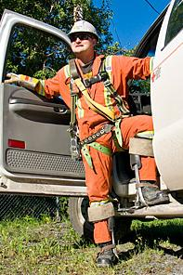
Worker Responsibilities and Rights
Workers are responsible for their own safety, as well as the safety of their co-workers and the general public.
Notes:
1-12
Who is Responsible for Safety
Ask Participants to comment on this and expand upon comments.
.

Slide 35

Worker Responsibilities & Rights
Right to Know
Right to Participate
Right to Refuse
Notes:
1-12

Slide 36
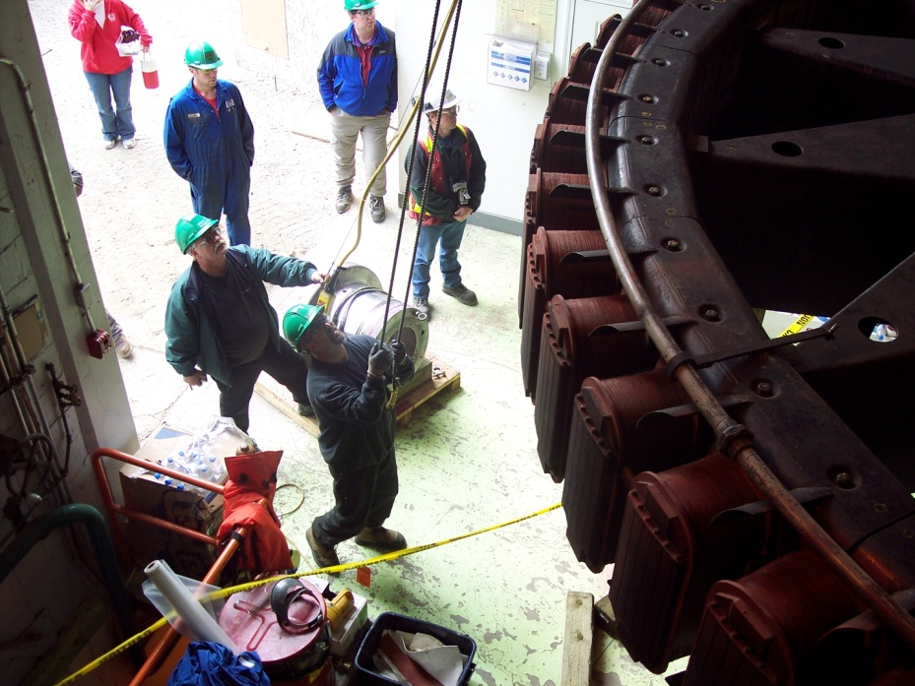
Right to Know
WHMIS
TDG
Job Hazard Identification
Safe Work Procedures
Equipment Operation
Ergonomics
Rules & Regulations
Notes:
1-12

Slide 37

Right to Participate
Each Worker has the right to participate in all matters relating to health and safety.
This can include participation on the JWHSC.
Notes:
1-12

Slide 38

Right to Refuse
Each Worker has the right to refuse work if they believe there is an unusual danger in the work they are asked to do.
Notes:
1-12

Slide 39
Competency Assurance
Qualification Verification
Training Verification
External Education
Experience Verification

Slide 40
Practical Competency Verification
Operating the equipment in a proper, safe, controlled manner in accordance with the
manufacturer’s specifications;
Reading and understanding the operating instructions;
Checking that all hazards have been identified;
Competency Checks (based on the industry’s accepted standards) completed by the supervisor;
All practical competency verification should be performed using a documented process, such as a check sheet, to ensure consistency and thoroughness.
Follow up or repeat verification is often necessary.

Slide 41
Sample
Tasks & Proficiencies | Mentor Signature | New Employee Signature | Date
Orientation
Client Orientation
Demonstrates Proficiency Using risk Matrix System
Demonstrates Proficiency Using THA’S
Demonstrates proficiency Using Observation Card System
Attended a Weekly Safety Meeting
Understands the Incident Reporting Process
Understands and applies Site Rules
Understands and can demonstrate the ERP Plan
Participated in Tailgate/Toolbox Meeting
Understands Drug and Alcohol Policy

Slide 42
Joint worksite health and safety
committee
An employer shall establish a Committee
(a) at a worksite where 20 or more workers
work
If fewer the 20 workers work at a worksite and there is no committee, each employer shall designate one worker as the occupational health and safety representative for the workers.

Slide 43
Roles of JOSH Committee
Bring OHS concerns into the open, and focus attention until employer resolves issue
Address outstanding concerns that someone has reported and is still not corrected.
Recommend corrective actions to employer
Perform inspections in the workplace

Slide 44
Functions of the Committee
Accident/Incident Investigation
Accident Prevention Initiatives
Joint Inspections
Hazard identification
Determination of the risk posed by those hazards
Creating Job Hazard Analyses (JHA’s)
Communicating the hazards, risks and controls
Promote best practices / helps ensure compliance
Solving internal health & safety problems rather than being directed by a WSCC Safety Officer or the Chief Safety Officer

Slide 45
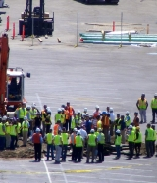
Prevention
Safety Meetings – Types
General All-Staff Safety
Monthly Safety by Location or Workgroup
Monthly JOSH Committee
Tailboard / Toolbox
Notes:
Conducted by Supervisors and Workers and are an essential to incident prevention.
Identify hazards
Take action
Determine controls
Recommend and record actions3-27

Slide 46
Prevention
Workplace Inspections
Identify and record hazards
Take action
Determine controls
Recommend and record actions
Notes:
3-28
Conducted by Supervisors and Workers and are an essential to incident prevention.
Identify hazards
Take action
Determine controls
Recommend and record actions

Slide 47
Prevention
WSCC Inspections
Inspections are chosen by past history, claims activities, work activities.
Inspections are conducted by SO, and employer representative, worker representative, JOSH, and union representative.
Observations are made.
Imminent danger results in stop work order
Non-compliance results in directions

Slide 48
Prevention
Inspection Report
Completion time for compliance report agreed upon.
Once direction complete, employer must notify officer.
Once all directions complete, employer must notify officer.
Past due items result in Non-Compliance Letter.
Seriously past due items can result in Stop Work Order for potential danger or legal action

Slide 49

OHS Program Development
WSCC has
published a step
by step guide on
building an OHS
program
Notes:
This is the guide for Small businesses.
The guide is available in hard copies, on the WSCC website and in a memory stick.
Workshops available upon request.

Slide 50
Reporting to Chief Safety Officer
  Annual Statistical Reports
  Notice of High Hazard Work
  Accident Causing Serious Bodily Injury
  Dangerous Occurrences
    Breaking a power pole in half
    Hospitalization
    Concussion
    Falling from heights
    Etc.

Slide 51
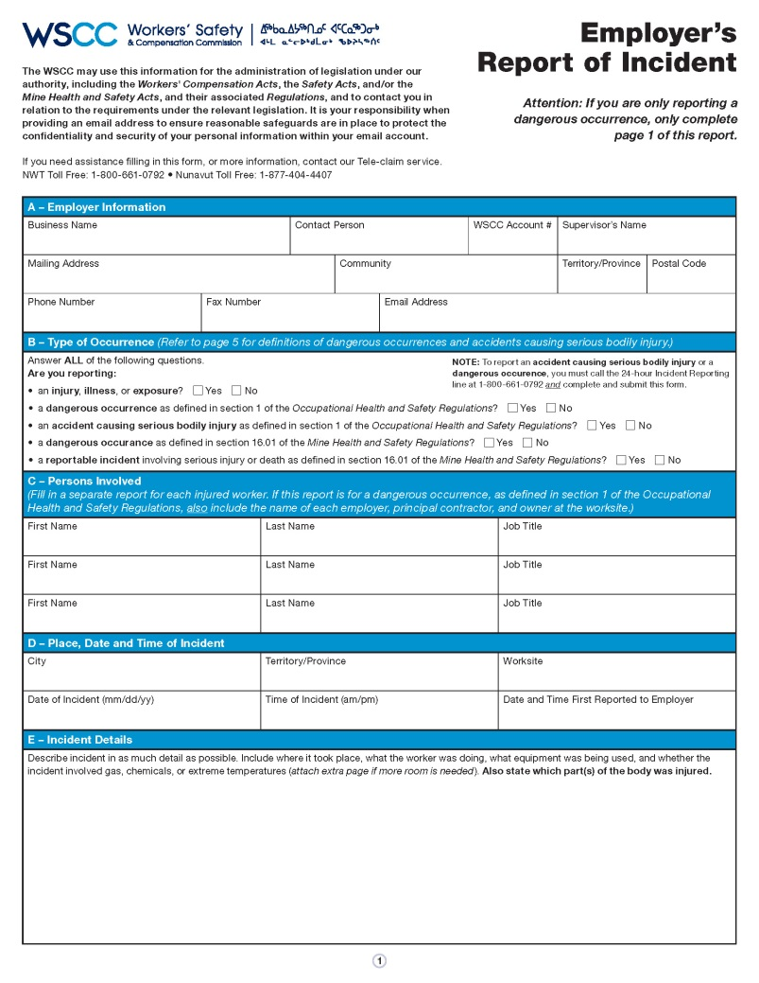
NEW Form:
Employer’s Report of Incident
Accident Causing Serious Bodily Injury form
+
Dangerous Occurrence form
+
Current Employer’s Report of Injury form
=
Notes:
Soon, WSCC will be introducing a new way for employers to report any workplace incidents. We have listened to feedback from employers on the current reporting process, and are happy to announce that in an effort to make reporting easier for employers, we have developed a new Employer’s Report of Incident form, which replaces three existing forms: the Accident Causing Serious Bodily Injury form; the Dangerous Occurrence form; and the current Employer’s Report of Injury form.

Slide 52
Why the New Form?
Employer Reporting Process becomes:
  Clearer (less confusion!)
  More convenient (less forms!)
Will help employers fulfill reporting requirements under the Safety Acts, OHS Regulations, and Workers’ Compensation Acts.
Notes:
SO WHY THE CHANGE?
In a brief survey conducted last year:
17% of surveyed Employers said our current reporting process is confusing or very confusing;
57% of surveyed Employers were unaware of the requirement to report to both the Claims and Prevention units; and
56% of surveyed Employers say they are somewhat aware or not aware of the requirement to report Dangerous Occurrences to the Chief Safety Officer.
Simply reporting an injury under the Workers’ Compensation Act to WSCC’s Claims Services through the current Employer’s Report of Injury form does not fulfill reporting requirements under the Safety Acts and related Occupational Health and Safety Regulations. Depending on the incident, notices must also be given to the Chief Safety Officer to report an Accident Causing Serious Bodily Injury or a Dangerous Occurrence.
We understand that the current reporting process may be confusing – it is inconvenient to have to submit multiple forms to two separate units! – therefore, instead of trying to determine what the incident category is, which form to submit, and to whom, there will now be one way to report all incidents. This will ease the reporting process for employers, and help fulfill all reporting requirements.
Furthermore, missing incident or dangerous occurrence reports prevents the WSCC from investigating workplace incidents or exposures and may limit our ability to prevent future workplace diseases and injuries.
This change applies only to the current reporting process for employers; the reporting process for injured workers has not changed.
The new form is scheduled to launch in May 2017. For additional details, take a look at our April issue of SafetyNet.
Once this form is available, we will be sending all Employers an email linking to the new form, and further explaining anything you need to know. We are also updating our website to reflect the new reporting process; any reference to the previous process will no longer be online. If you have any hyperlinks or PDFs saved to your computer, please update them to the new system.

Slide 53
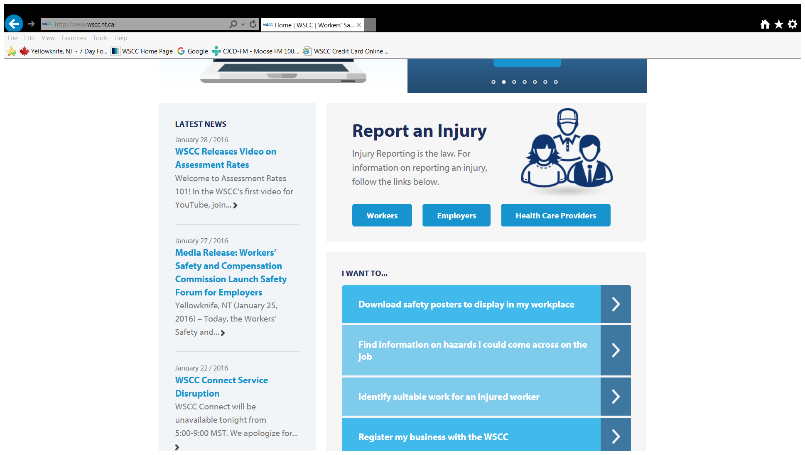
THE WEB SITE – WSCC.NT.CA

Slide 54

Skip to main content
Careers
Contact Us
Legislation
Policy
facebook
twitter
English
Français
Innuinaqtun
Inuktitut
Search form
safetyConnect
Home
Health & Safety»
      OHS Information
      Reporting Requirements
        Notices and Approvals
      Safety Legislation
        New OHS Regulations
      Know Your Rights
      Codes of Practice
      Hazard Alerts
      WHMIS
      Safety Bulletins
      Posters
      Safety Program Toolbox
    OHS Education
      Approved Providers
    OHS Links
    Events
      NAOSH Week
      Day of Mourning
      Mine Rescue Competition
      Skills Canada
      #It'sYourJob Video Contest
Employer Services»
      Register a Business
    Request a Clearance
    Report Payroll
    Rate Classifications
    Brochures and Guides
    Forms
    Safe Advantage
    Frequently Asked Questions
    Reviews and Appeals
Claims Services»
      Claims for Workers
      Report an Injury
      What to Expect with Your Claim
      Reviews and Appeals
        Reviews
        Appeals
      Workers' Advisor
      Workers' Rights & Responsibilities
      Brochures & Guides
      Forms
      Frequently Asked Questions
    Claims for Employers
      Report an Injury
      Reviews and Appeals
        Reviews
        Appeals
      Employers' Rights & Responsibilities
      Brochures & Guides
      Forms
      Frequently Asked Questions
    Claims for Health Care Providers
      Report an Injury
      Brochures & Guides
      Forms
      Frequently Asked Questions
Return to Work»
      RTW for Workers
      Return to Work Process
      Forms
      Resources
    RTW for Employers
      Return to Work Process
      Develop a Return to Work Program
      Forms & Templates
      Resources
    RTW for Health Care Providers
      Your Role in Return to Work
      Forms
      Resources
    Identify Suitable Work
About WSCC»
      The Meredith Principles
    Vision, Mission & Values
    Governance
      Governance Council
      Organizational Chart
      President & CEO
    Newsletters
    Reporting & Accountability
      Corporate Plans and Reports
      Financial Accountability
      Key Statistics
      Service Standards
    Policy & Legislation
      Policy Manual
      Policy Development Process
      Legislation
    Stakeholder Engagement
      Current Engagement Opportunities
      Stakeholder Engagement Committee
    Partnerships
    Careers
    Tenders & Proposals
    Contact Us
SAFETY SHARE IS NOW LIVE!
Employers, collaborate and share workplace safety information.
More
WSCC CONNECT IS NOW LIVE!
View our new e-Business Services
More
OUR COMMITMENT TO YOU
WSCC Vision, Mission, and Values
More
WSCC RELEASES NEW CODE OF PRACTICE
New Return to Work Program Development Code of Practice is available.
More
SAFE RETURN TO WORK
During recovery early and safe return to work increases physical and mental...
More
WHMIS 2015 IS HERE!
Familiarize yourself with the new system today!
More
OHS REGULATIONS: IT'S THE LAW!
New Occupational Health and Safety Regulations in effect.
More
1
2
3
4
5
6
7
Previous
Next
Latest News
January 28 / 2016
WSCC RELEASES VIDEO ON ASSESSMENT RATES
Welcome to Assessment Rates 101! In the WSCC’s first video for YouTube, join... Read more
January 27 / 2016
MEDIA RELEASE: WORKERS’ SAFETY AND COMPENSATION COMMISSION LAUNCH SAFETY FORUM FOR EMPLOYERS
Yellowknife, NT (January 25, 2016) – Today, the Workers’ Safety and... Read more
January 22 / 2016
WSCC CONNECT SERVICE DISRUPTION
WSCC Connect will be unavailable tonight from 5:00-9:00 MST. We apologize for... Read more
See all news
Home
Report an Injury
Injury Reporting is the law. For information on reporting an injury, follow the links below.
Workers
Employers
Health Care Providers
I want to...
Download safety posters to display in my workplace
Find information on hazards I could come across on the job
Identify suitable work for an injured worker
Register my business with the WSCC
Legal
Access to Private Information
Report Fraud
Media Centre
facebook
twitter
Follow Us
© 2015 Workers' Safety and Compensation Commission of the Northwest Territories and Nunavut
SAFETY SHARE
REPORT UNSAFE WORK

Slide 55

OHS APP
Notes:
The OHS Legislations requires you to be familiar with the Safety Act and the regulations that apply to the work you do.
Don’t get overwhelmed by the sheer number of regulations (and there are 490)
You don’t get to claim that you didn’t know what the rules were.
But we recognize that you may read the regulations and
have some questions about how to do what you need to in order to meet the requirements.
WSCC, working with CCOHS, are proud to announce the launch of a new tool for you!
The OHS app provides you with the ability to quickly access safety information at the tip of your fingers. Right now, we’re soft launching the webtool portion, accessible online through our website.
Lets take a look!
This tool gives quick summaries on specific safety topics, provides you with the relevant legislation associated with that topics, and also links to any WSCC existing resources to help spread safety awareness.
This summer, we’ll be rolling out the OHS App, downloadable on your smartphone. No matter where you, no matter the cell service, you can find out important safety information. We’ll be continuing to grow this tool with more topics down the line – please explore it, let us know what you think, and if you have any ideas for future topics that you’d like to see! We want to be sure this tool is meeting your needs!

Slide 56

Notes:
This is the starting page to the OHS App webtool. You can get here by going to the WSCC homepage and clicking the OHS APP link at the top of the page, located next to the WSCC Connect button.

Slide 57
Up Coming & Current Items
Available on CCOHS: Free for NWT and NU, up to a 1000 + seats for online WHMIS 2015
OHS Guide for small business
CCOHS Web application: By 15 May
First Aid Training: Throughout the Month
NAOSH: Week
New Codes of Practice: Camps, Lead, Hazard Assessment,
Posters, Pamphlets, Safety Sheets, Toolbox Talk Books, First Aid Registers all available.

Slide 58
QUESTIONS?

Slide 60
What is Being Seen

Slide 61
Ladders
258. (2) An employer or supplier shall ensure that
    (a) a wooden ladder or stepladder is not painted with a substance other than a transparent coating;
260. (2) An employer shall ensure that a worker does not work from either of the top two rungs or steps of a portable ladder, unless the ladder is a stepladder that has a platform equipped with a suitable handrail.

Slide 62
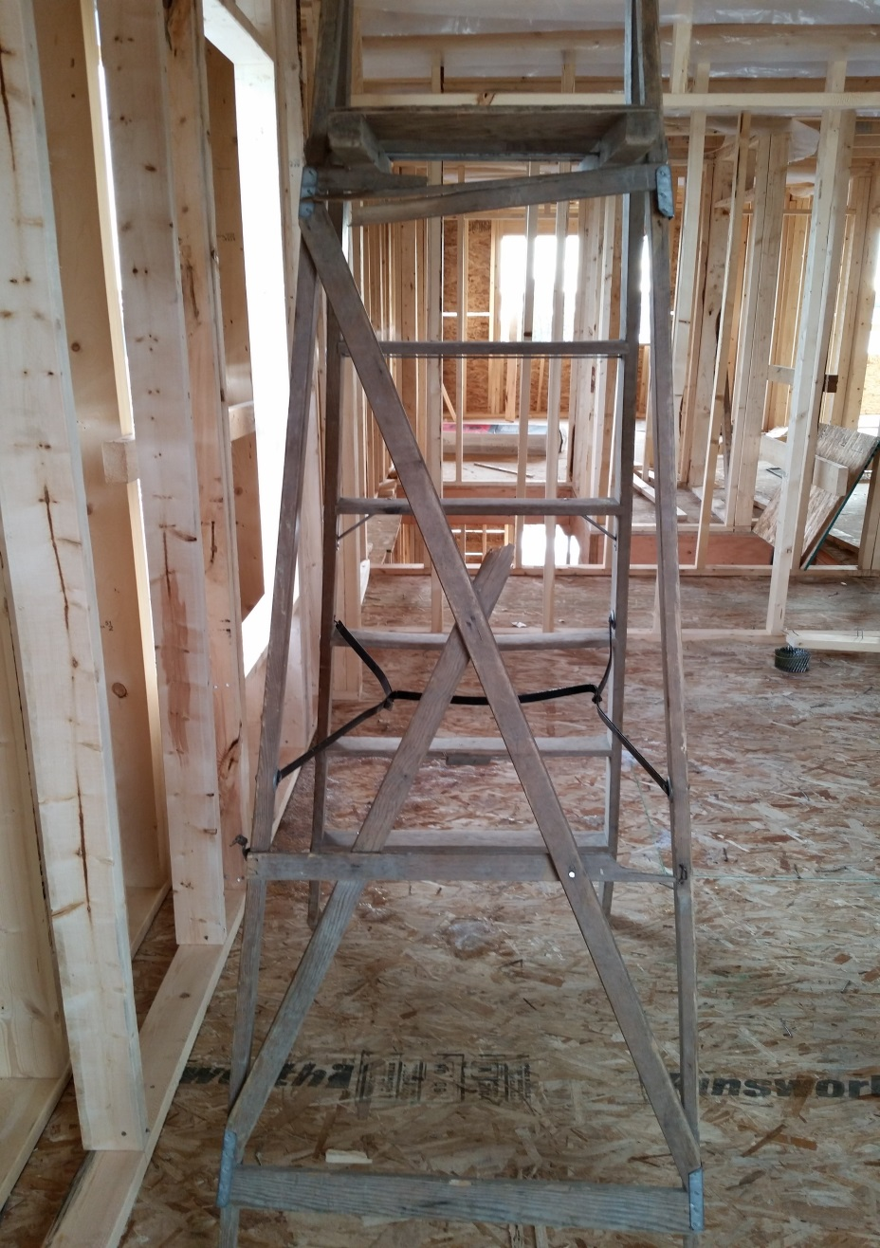

Slide 63
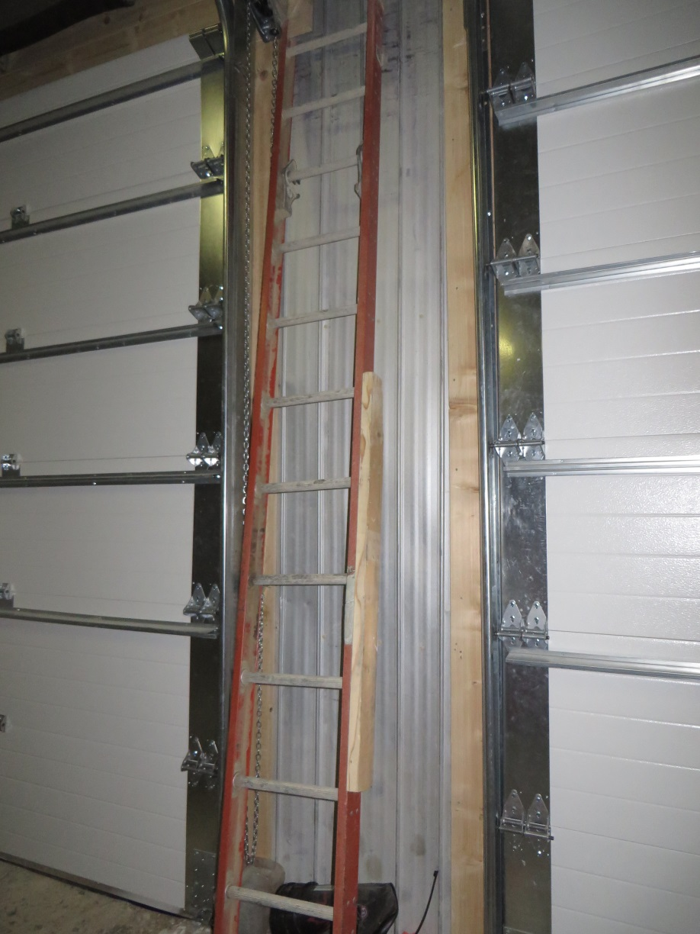

Slide 64
2015 Slips Trips and Fall Statistics:
1 in 5 claims were slip/trip/fall (20.7%)
October saw the most injuries
Knees most commonly injured body part.
WSCC:
  On average received 1.92 claims per day.
  paid out approximately $4,866,870 to 798 claims
  5 years, average claim costs $5,785.95.

Slide 65
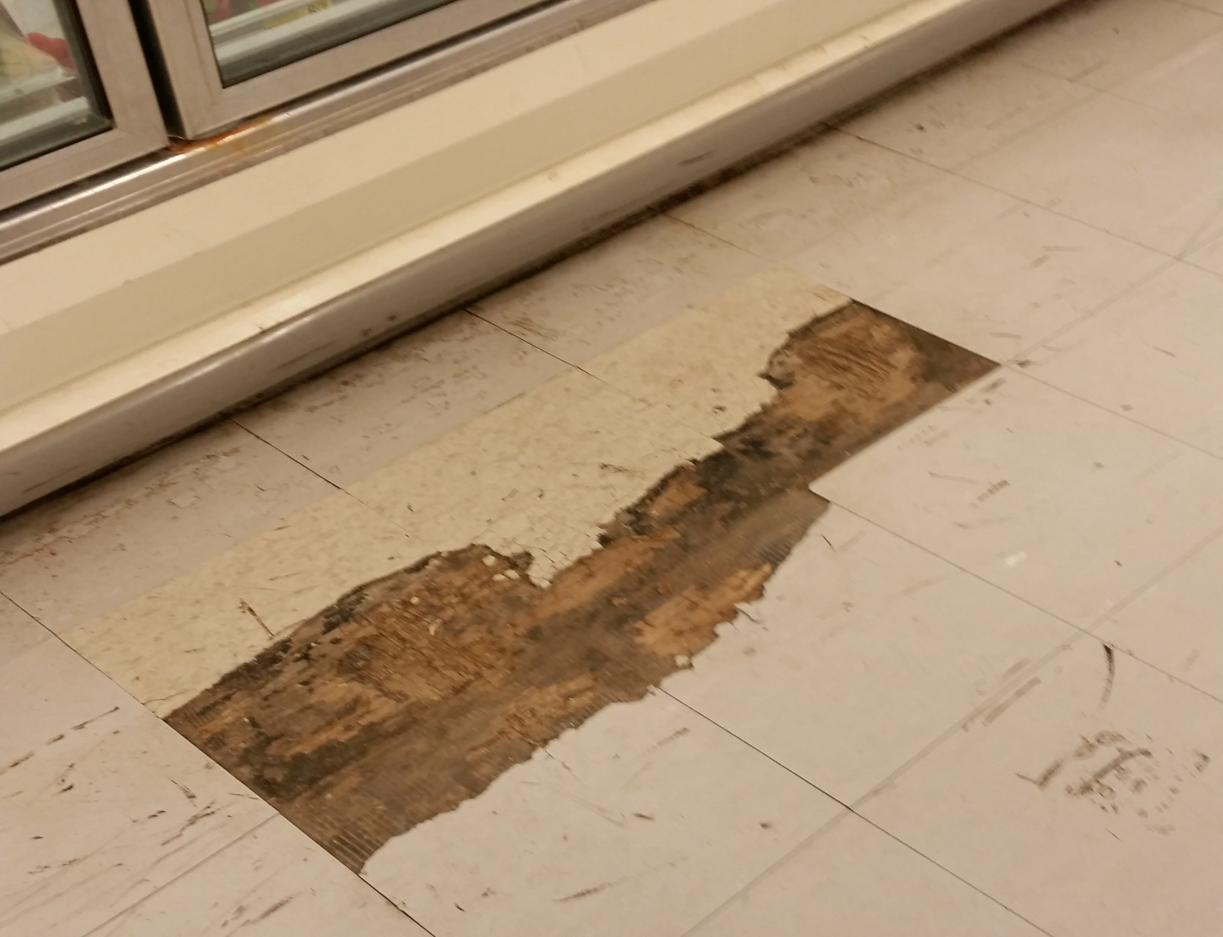

Slide 66
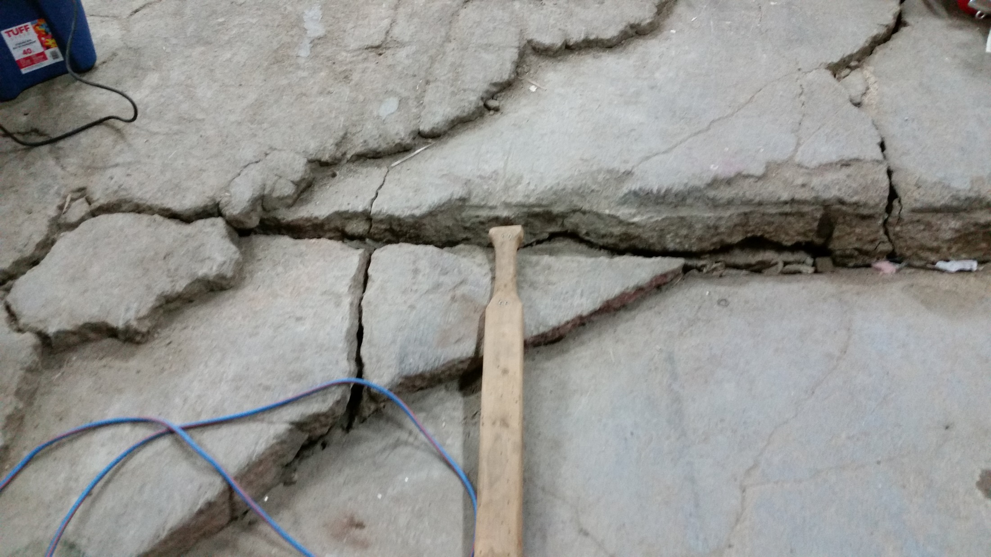

Slide 67
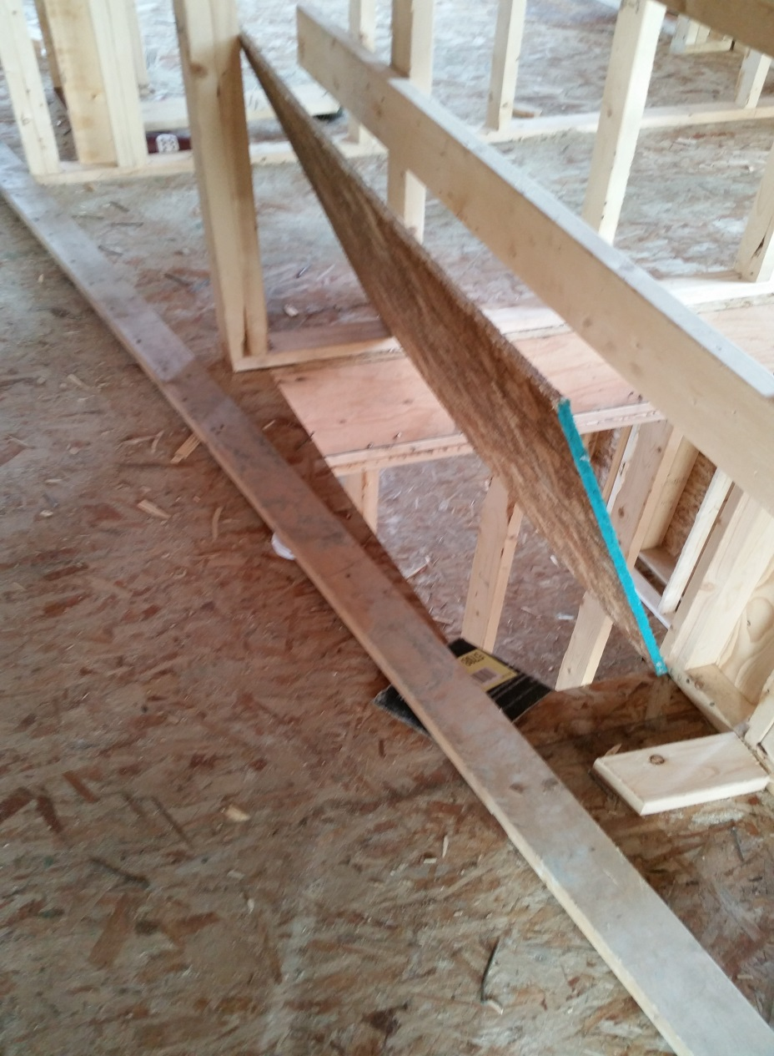

Slide 68
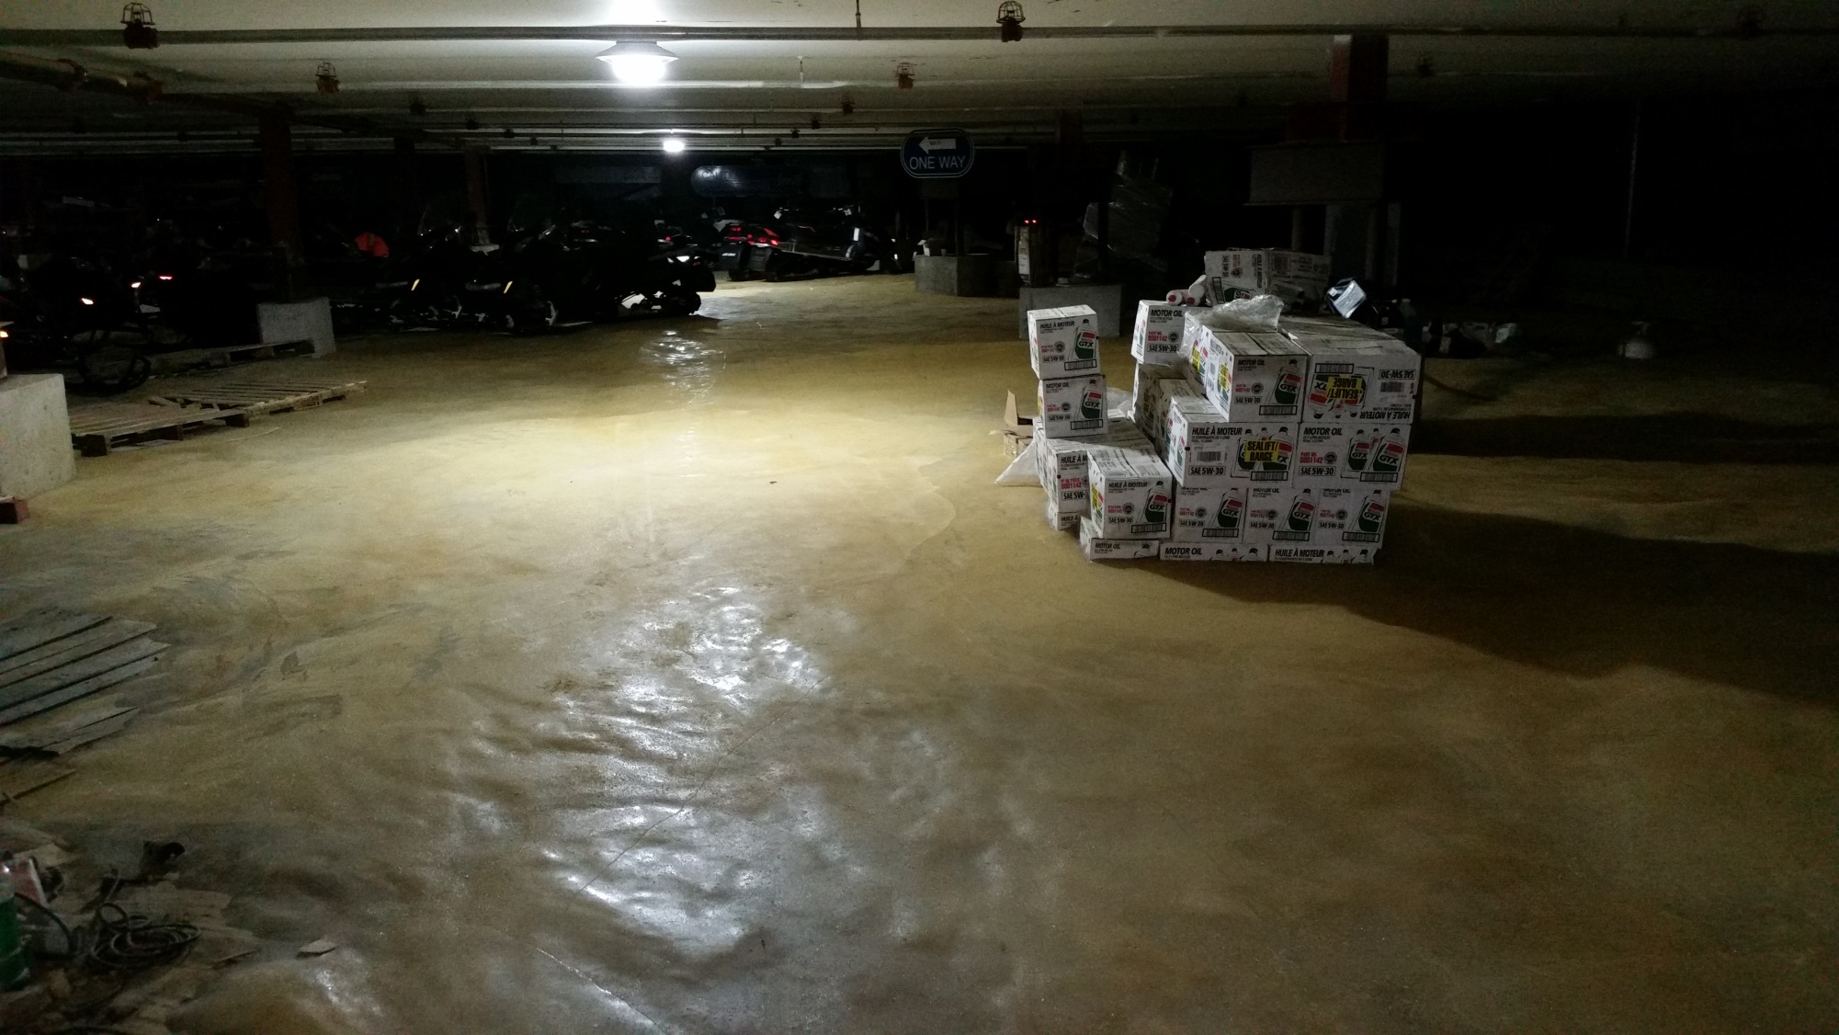

Slide 69
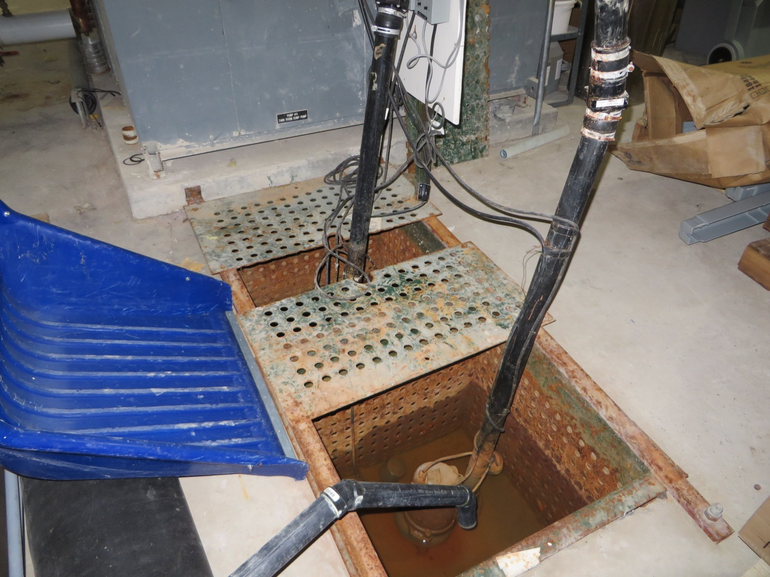

Slide 70
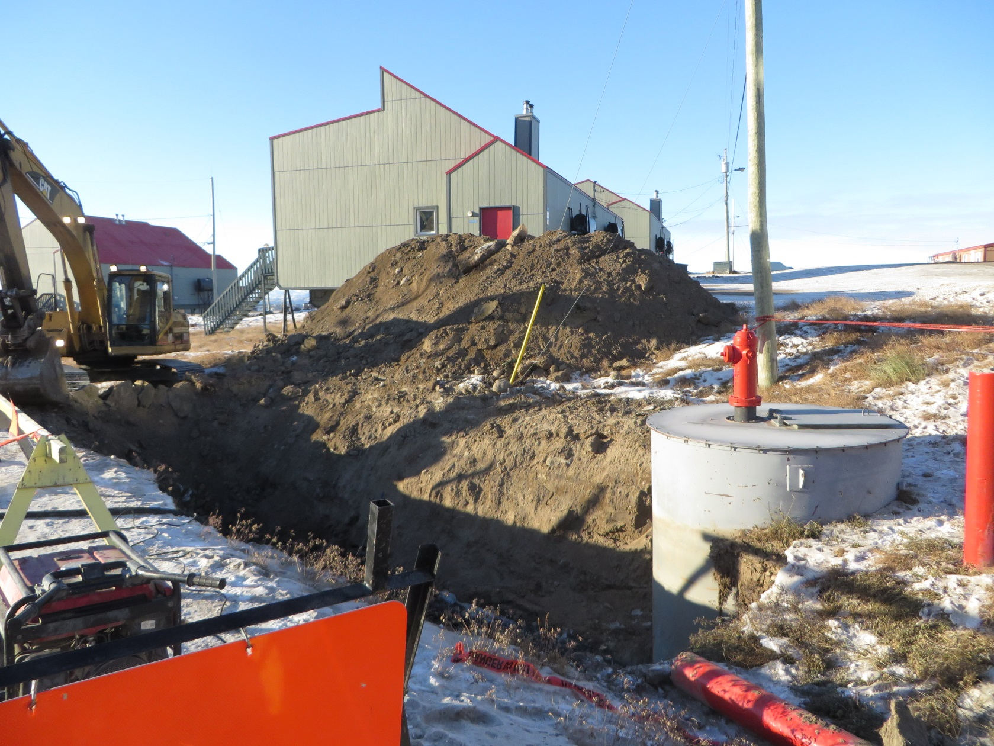

Slide 71
EMERGENCY EXITS
Keep door unobstructed
Not used for storage
Ensure safe egress

Slide 72
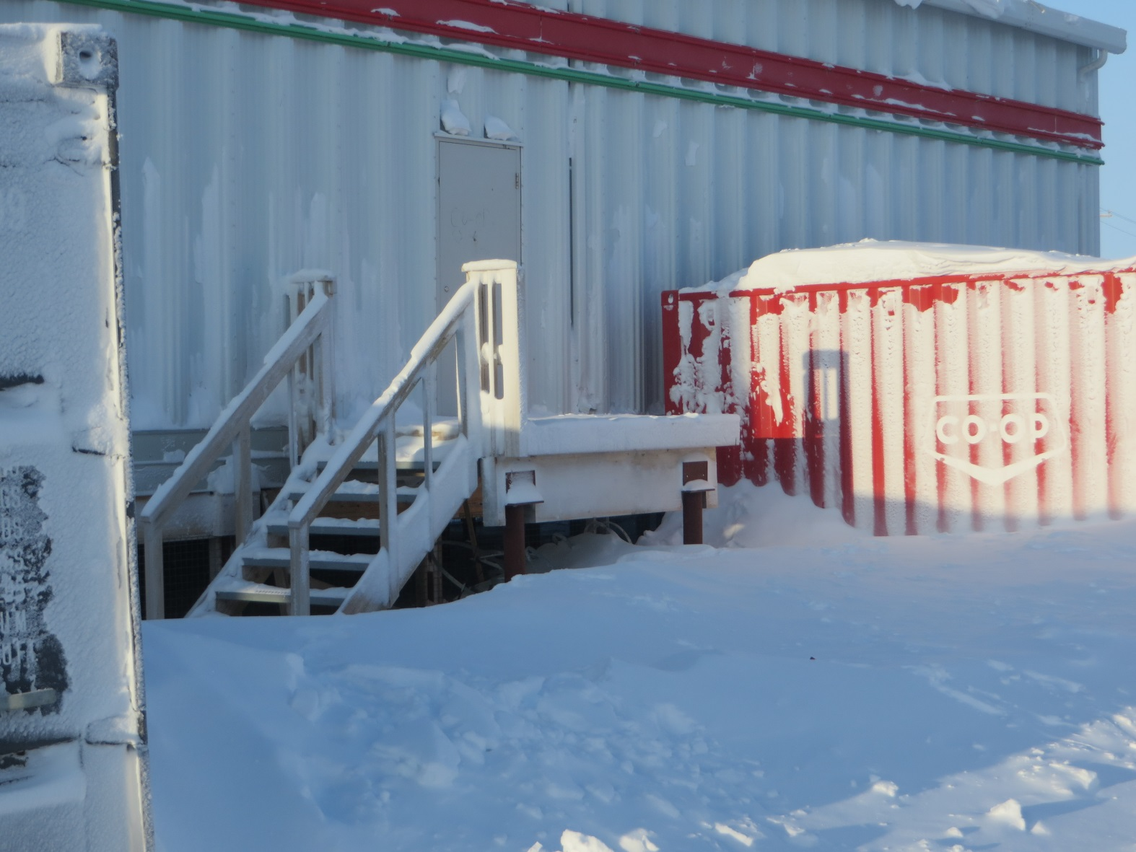

Slide 73
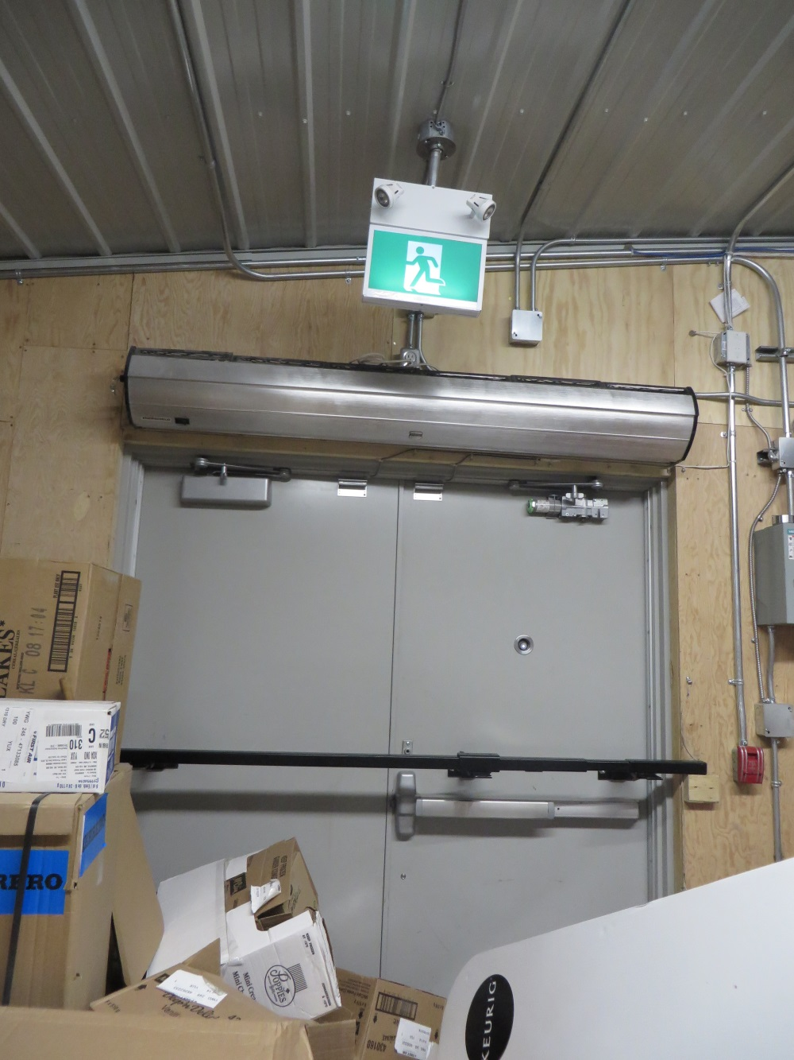

Slide 74
HAND TOOLS
Knives
Grinders

Slide 75
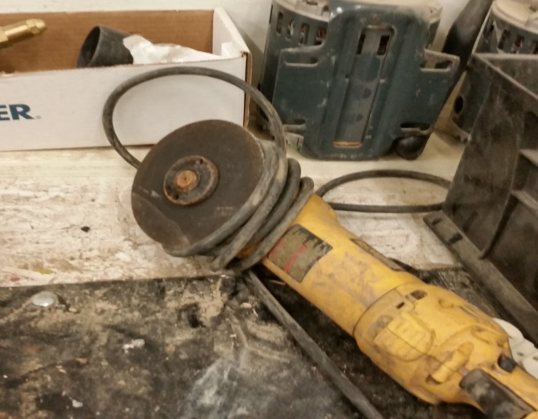
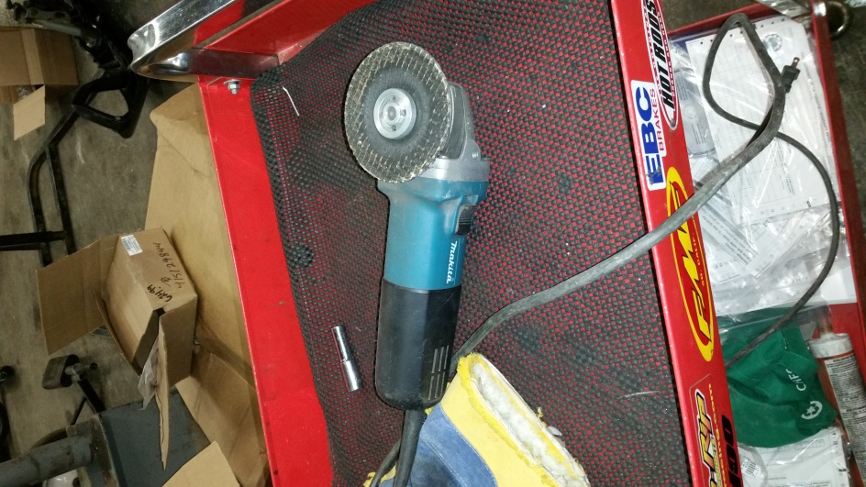
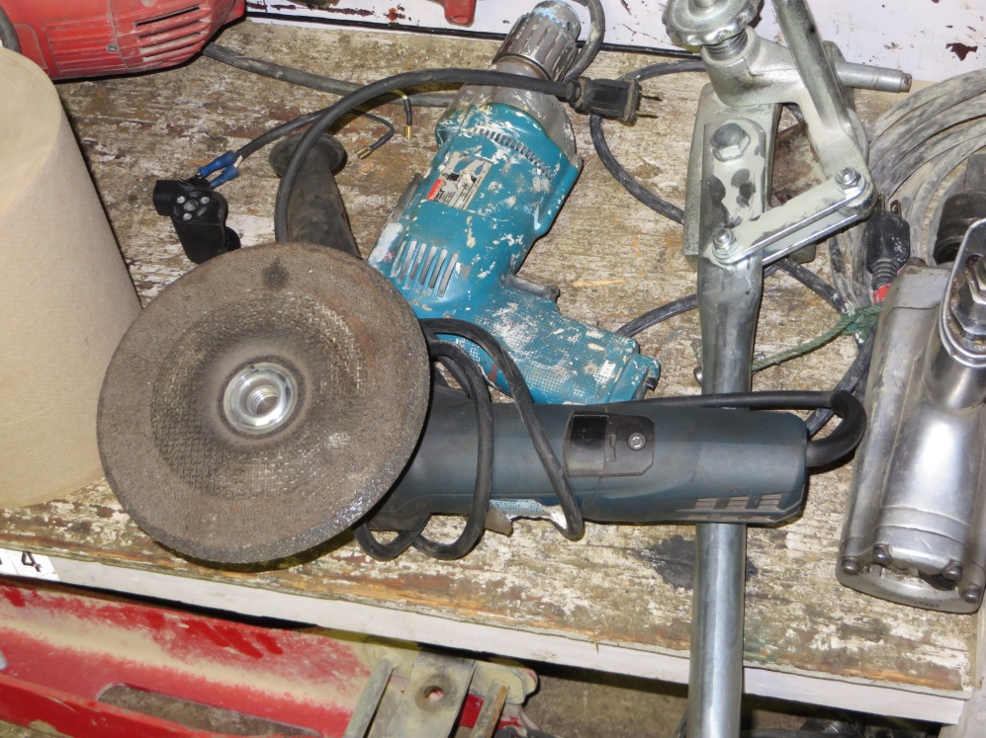
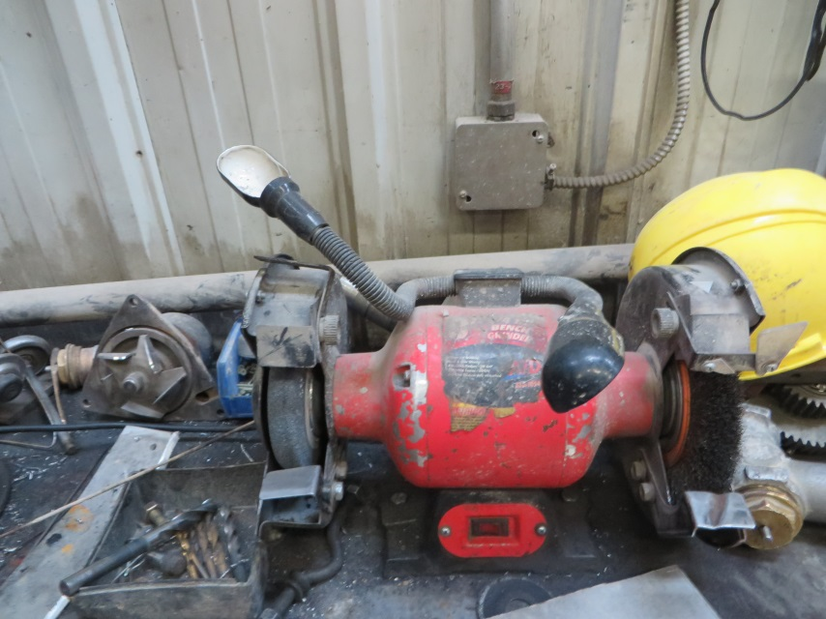

Slide 76
WHMIS
Training
Storage
Labels
SDS

Slide 77
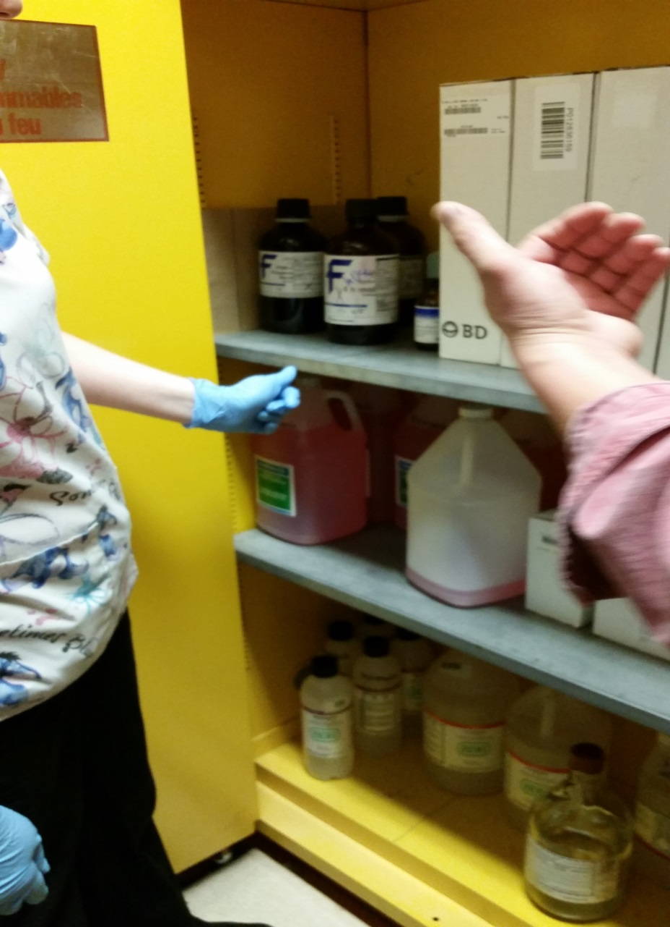

Slide 78
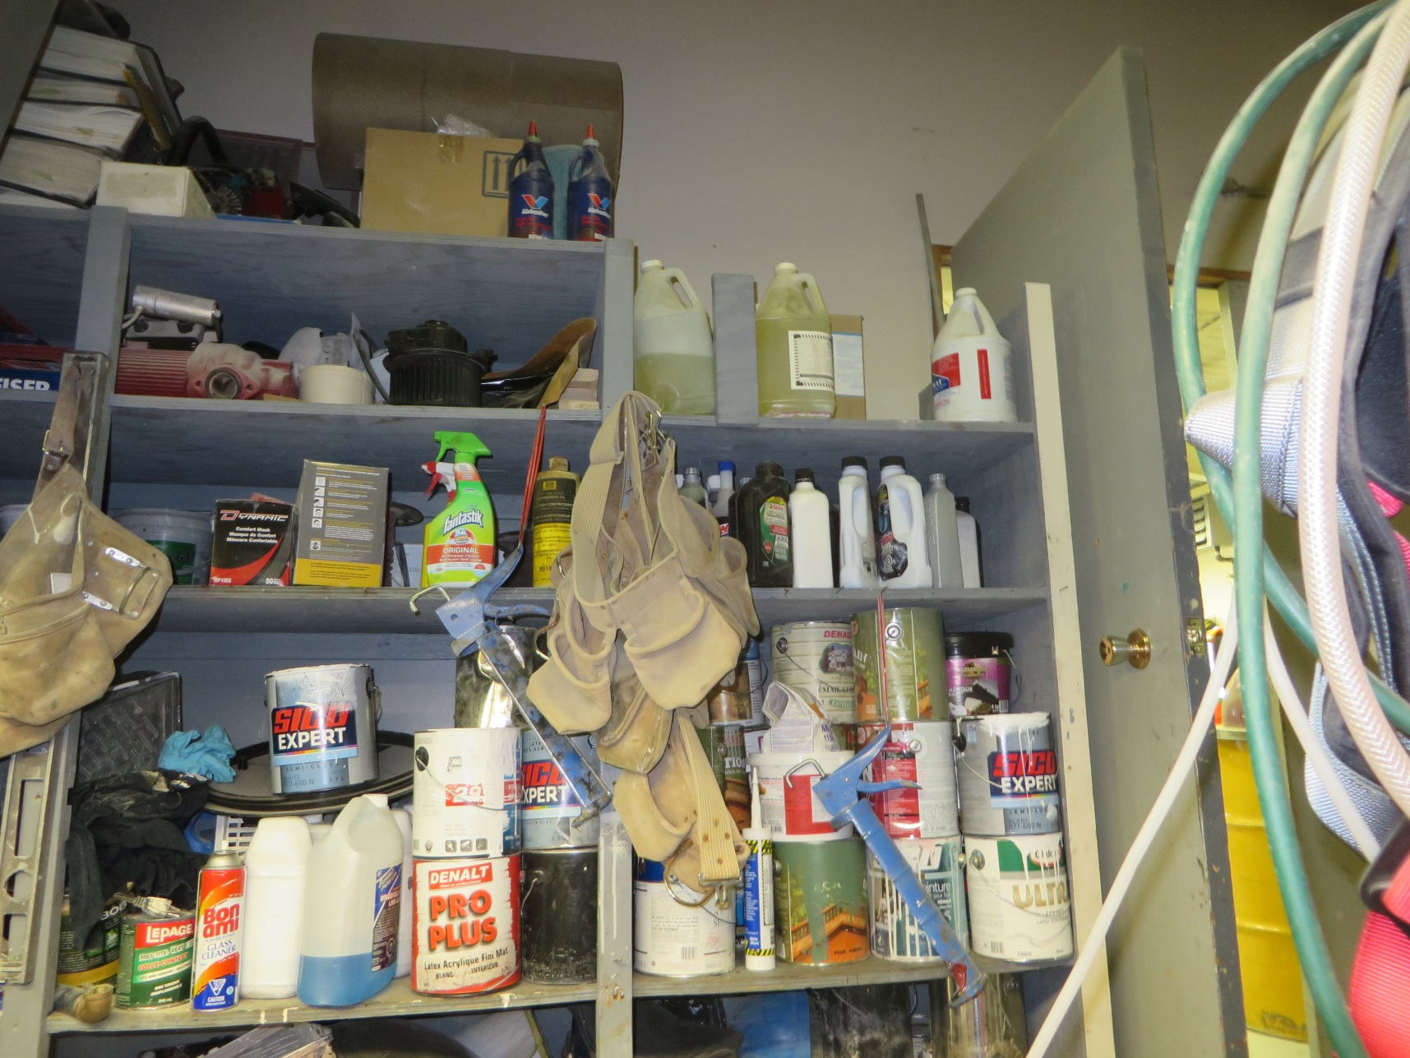

Slide 79
Asbestos in your buildings?
If a building has asbestos-containing material, all factors are considered to determine which method for controlling the material is appropriate.
The Control methods include:
  Asbestos Abatement: Remove asbestos material and replace it with non-asbestos material, APN Required
  Asbestos Management Plan: Ensure the material is not friable, is kept in good condition, and is inspected regularly
  Encapsulate Asbestos: Provide a covering that will prevent fibers from being released
  Enclose/Conceal Asbestos: Provide a solid barrier to prevent access to the asbestos material

Slide 80
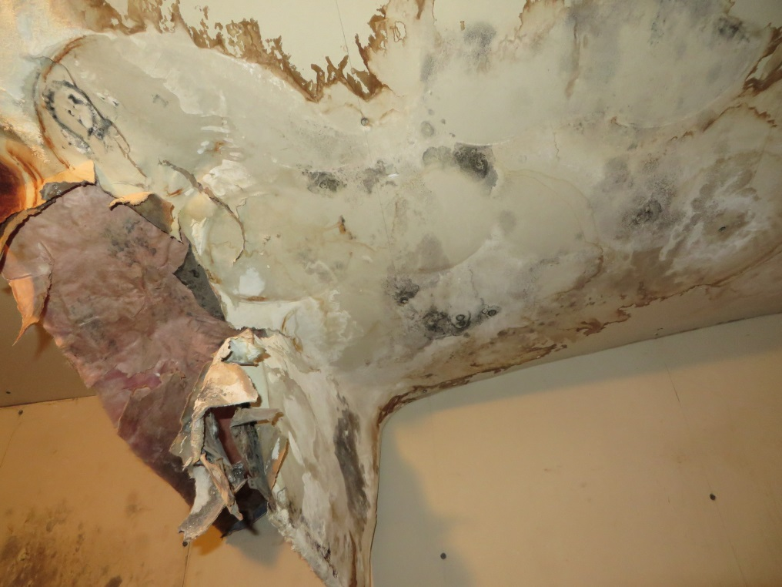
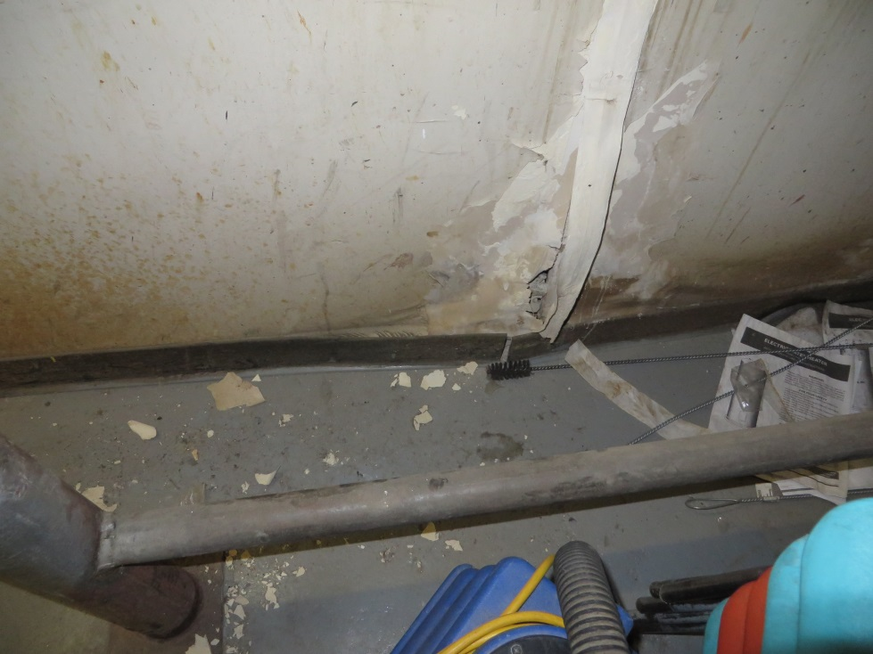

Slide 81
STORAGE
  Materials
  Propane
  Chemicals

Slide 82
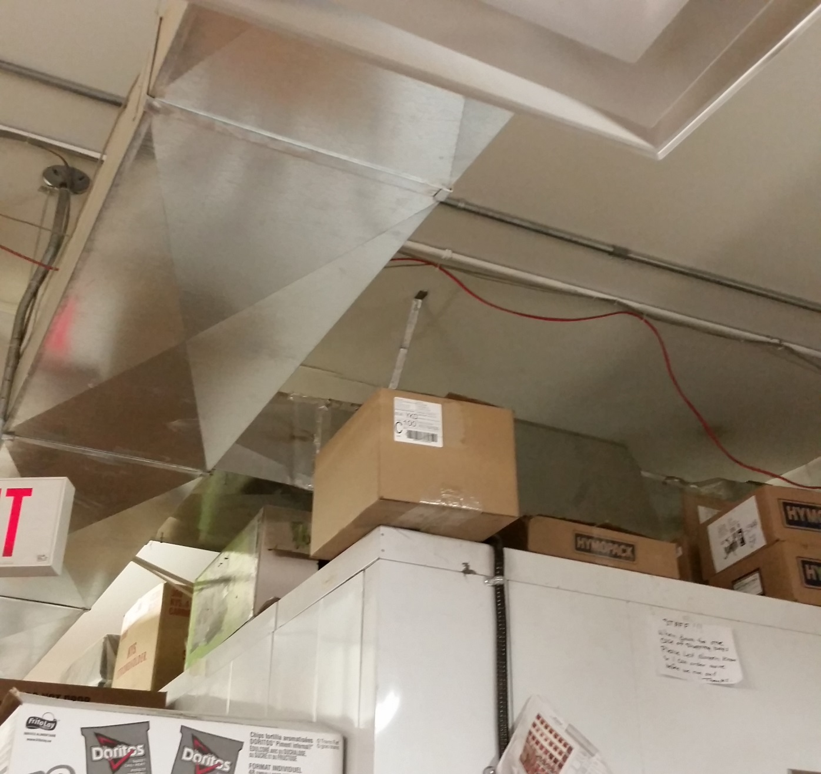

Slide 83
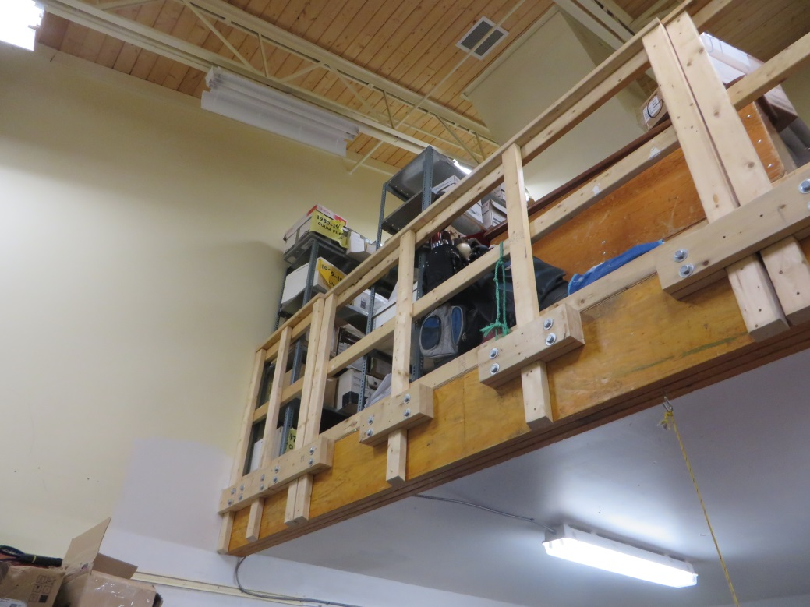
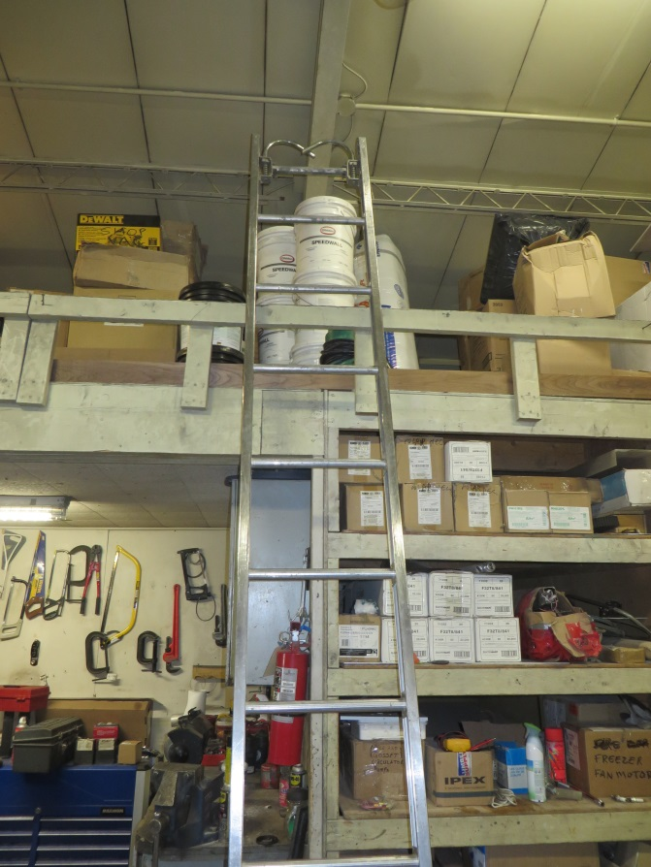

Slide 84
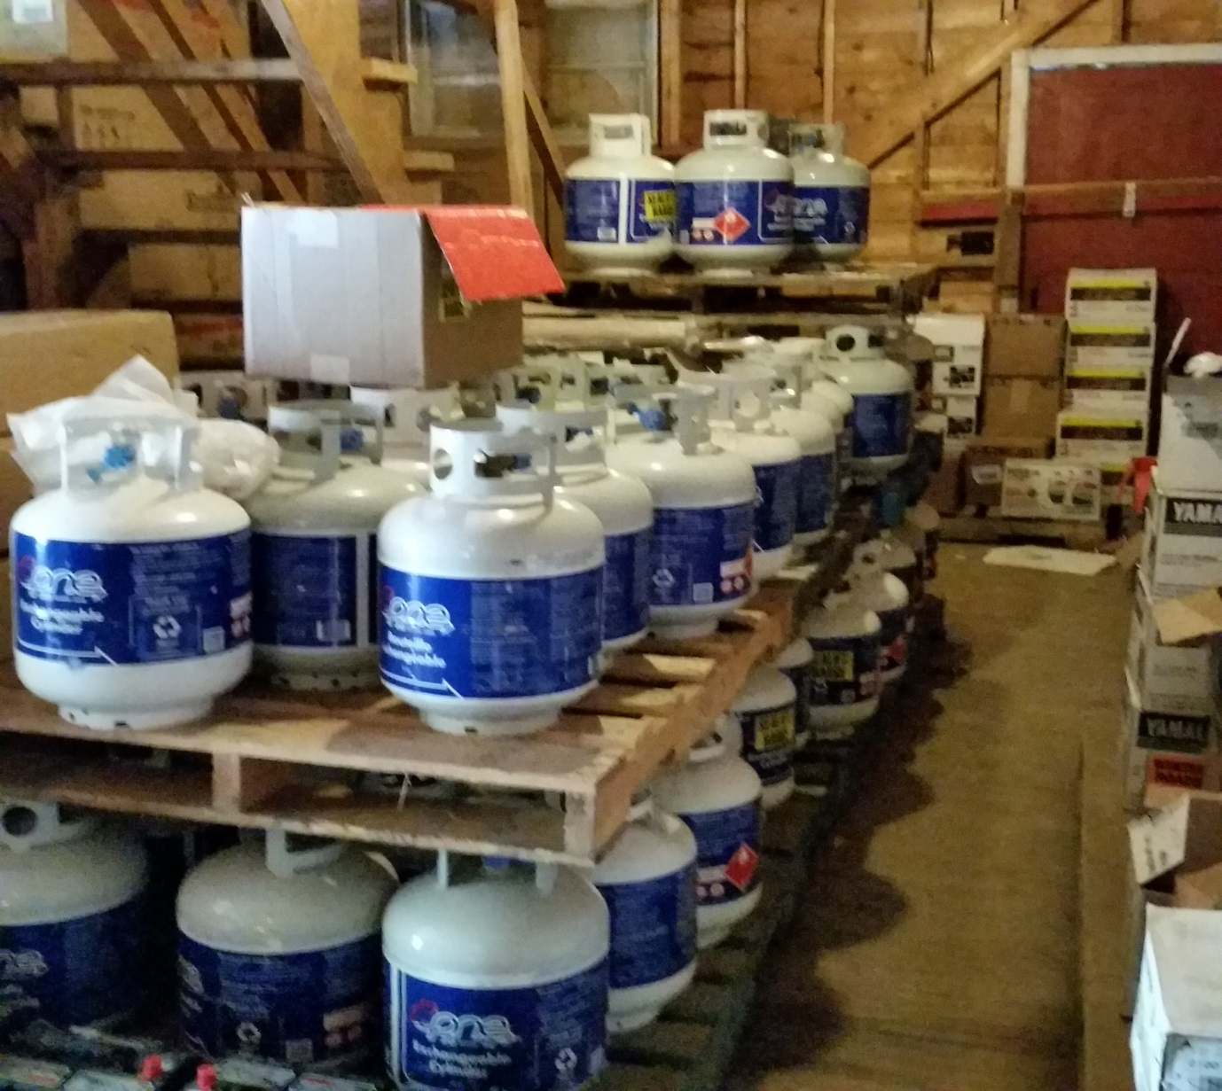

Slide 85
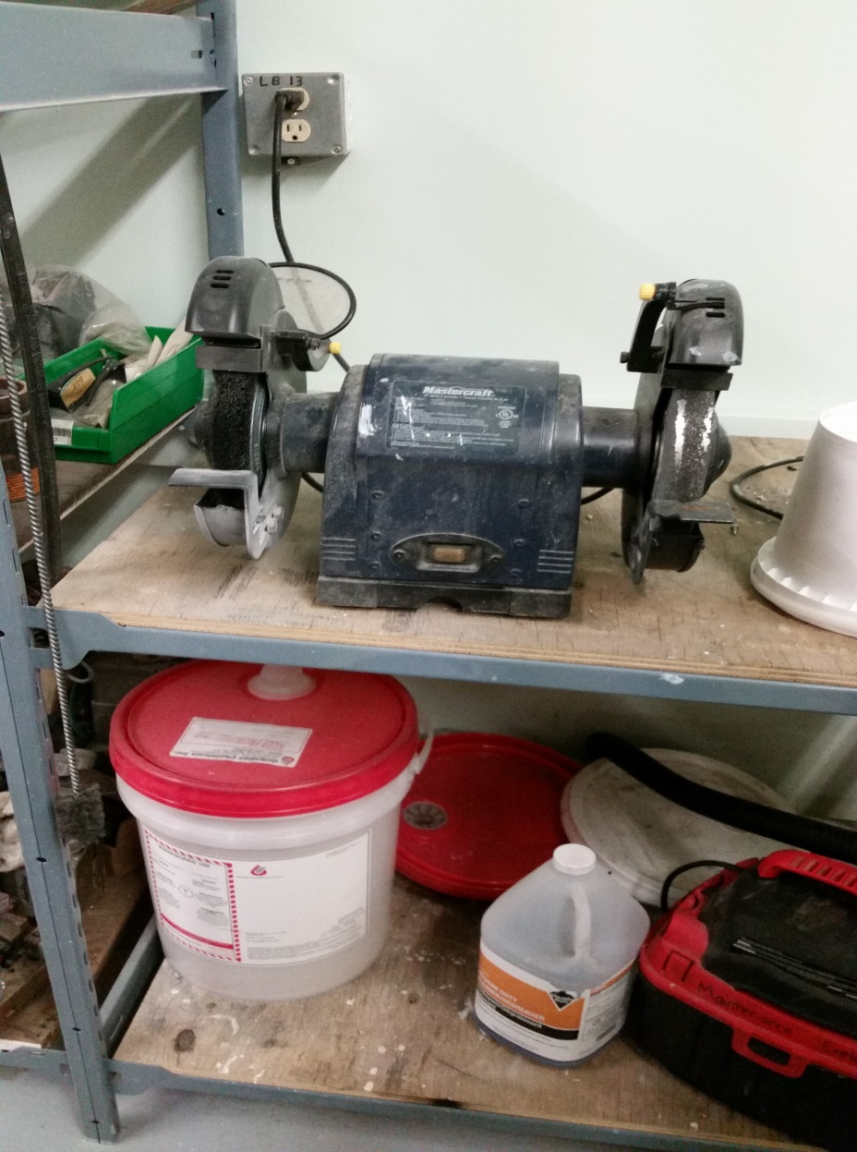

Slide 86
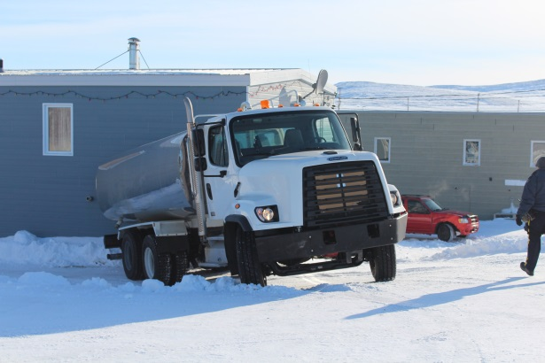
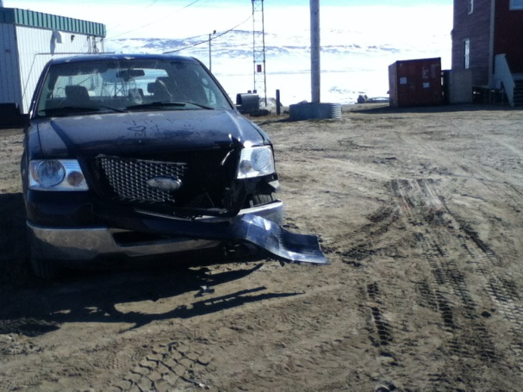
Vehicle Incidents
Collisions
Striking Objects
Not performing pre-use inspections
Unauthorized use
Unqualified use (Competency Checks)
No use of Spotters or Traffic Control

Slide 87
BACK TO THE BASICS
CONTROL HAZARDS
Elimination
Substitution
Engineering
Administrative
Personal Protective Equipment

Slide 88
WHERE
Can you go for assistance?

Slide 89
Conclusion
WSCC is working with employers and workers to ensure understanding and compliance.
We continue to:
  Develop tools to assist stakeholders
  Raise awareness of the changes
  Present information sessions

